Slide 1
Mendelian Randomization
Part II – Advanced Topics
NSHG 2023

Slide 2
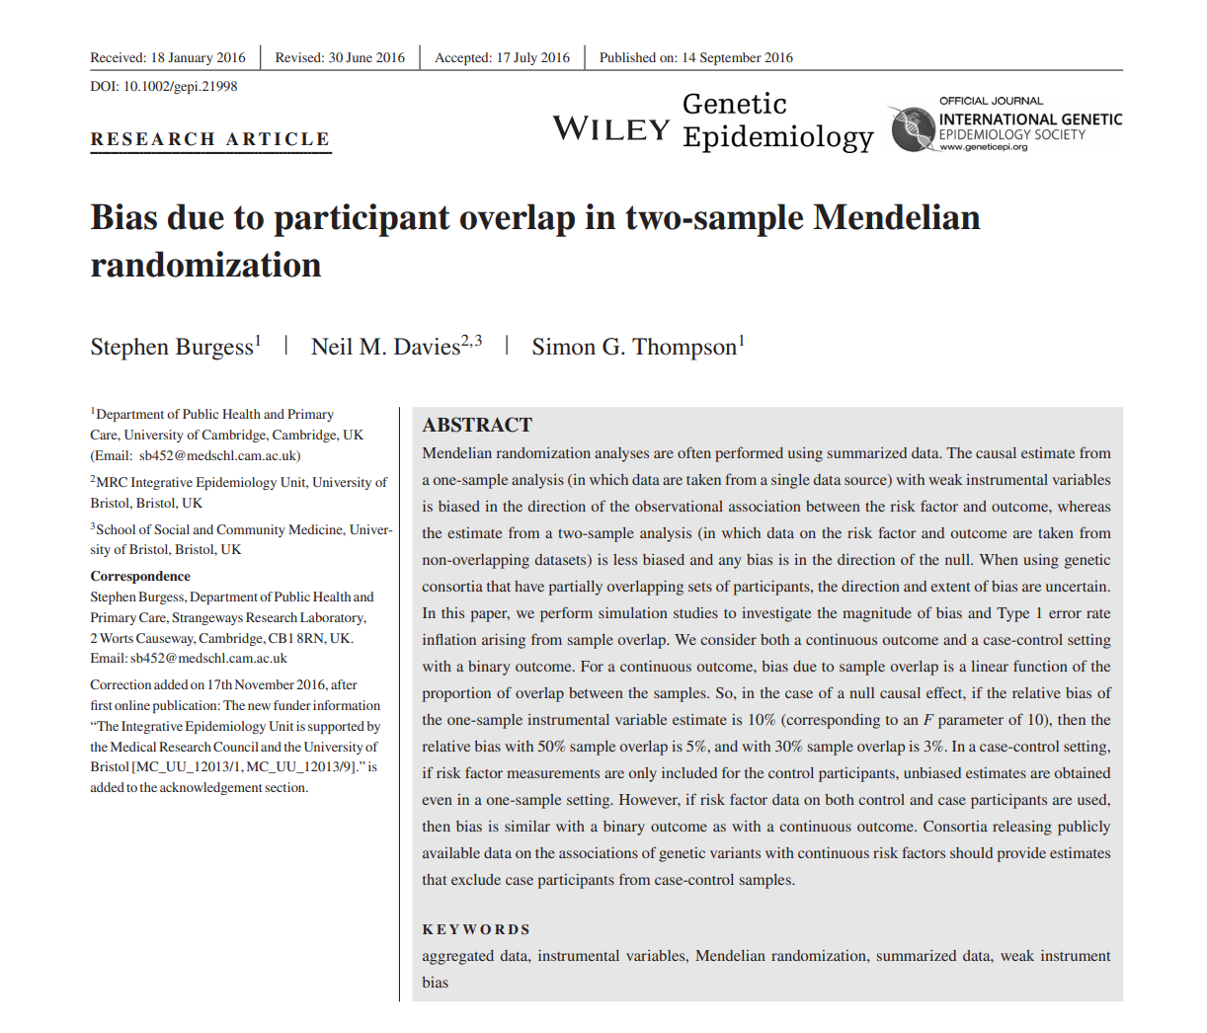
Sample overlap bias
Sample overlap can cause bias towards observational estimate
In QT traits
Sample overlap is ok in CC if we only have shared controls
Non-overlap means that any bias is in the direction of the null

Slide 3
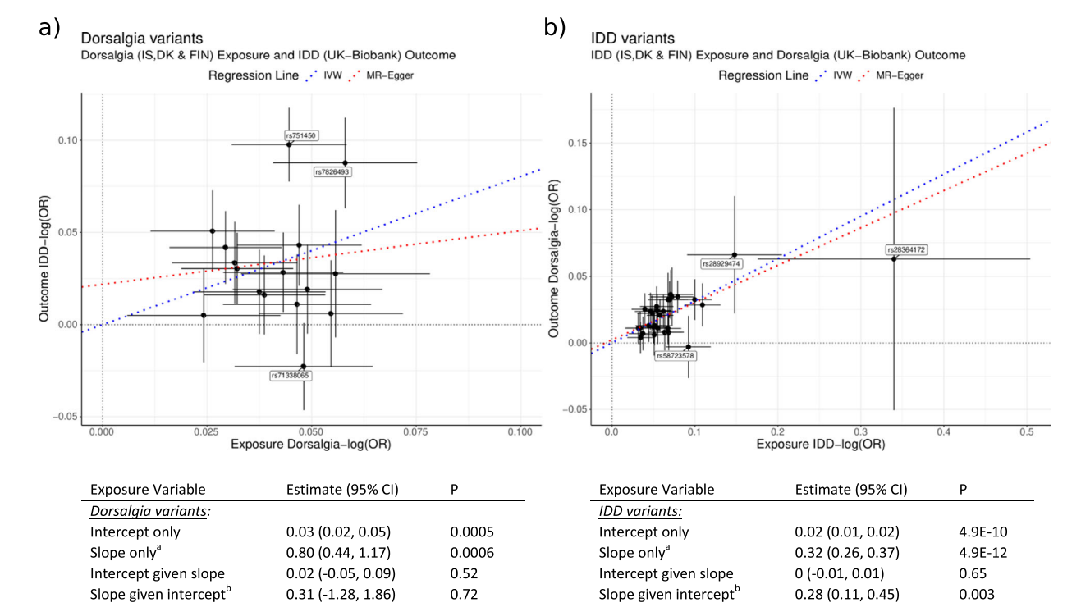
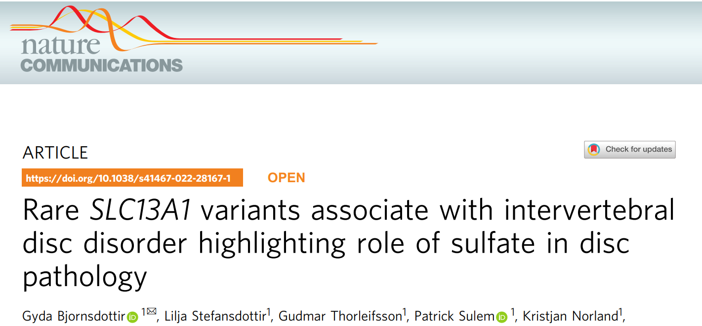
(intervertebral disc disorder)

Slide 4
MR vs PRS and Genetic Correlations
With more and more markers, MR should converge to something like a PRS score (using all genome wide variants)
With more power, we are not neccessarily getting more good instruments
Rare large markers are an exception
Certain complex traits have associations all over the genome
Colocalization starts to have an effect
Like we saw before, other issues come up
Reverse causality
Horizontal pleiotropy
These analyses find correlations between genetic components of different phenotypes
They have more power to find associations
Cannot infer causality, specifically in the case of small effects
Often they are a bit black box-ish
Results can be driven by few strong markers

Slide 5
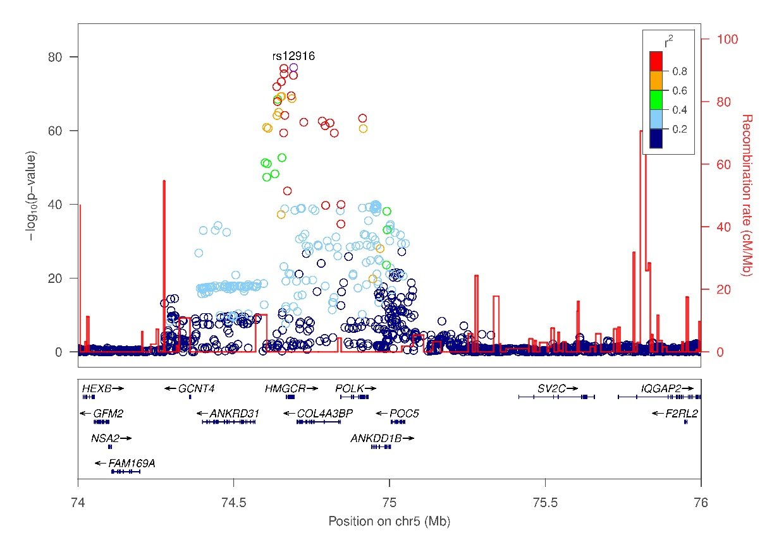
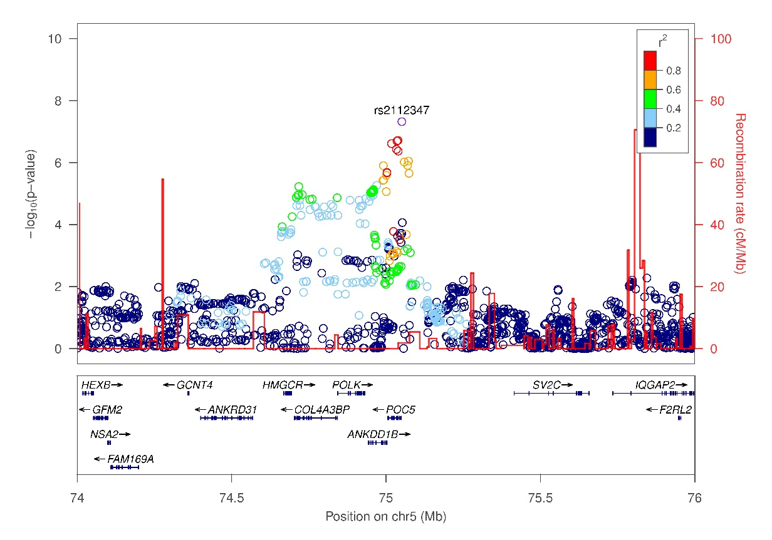
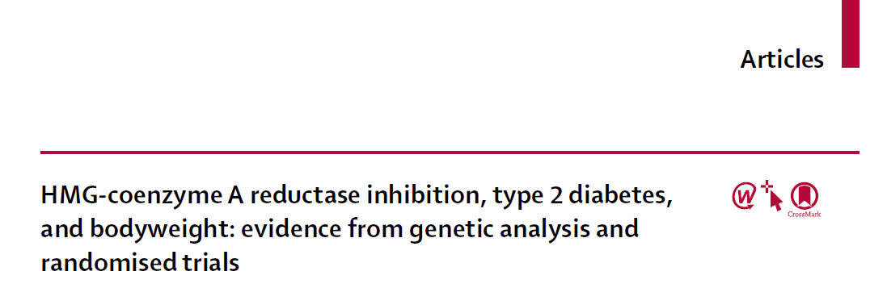
Co-localization example
LDL
BMI
LDL association in GLGC
BMI association in GIANT

Slide 6
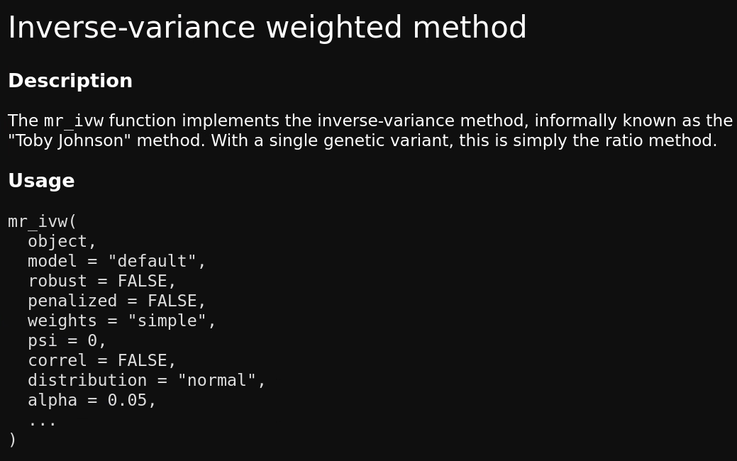
Normal vs t-distribution
Many methods offer options for distribution to use when computing Cis
This matters a lot when we have few variants
The normal distribution is an approximation, the t-distribution is the correct one
Also the case in gsmr

Slide 7
Example t-dist vs normal
Exercise to investigate this

Slide 8
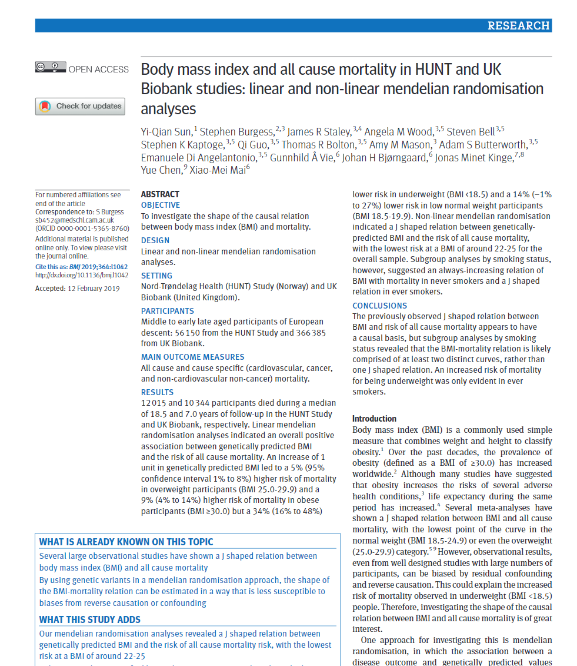
Nonlinear MR
Epidemilogical data often suggests that the relationships are not linear
This can also be due to confounding
Nonlinear MR allows one to test for presence of nonlinearity
Requires immense power

Slide 9
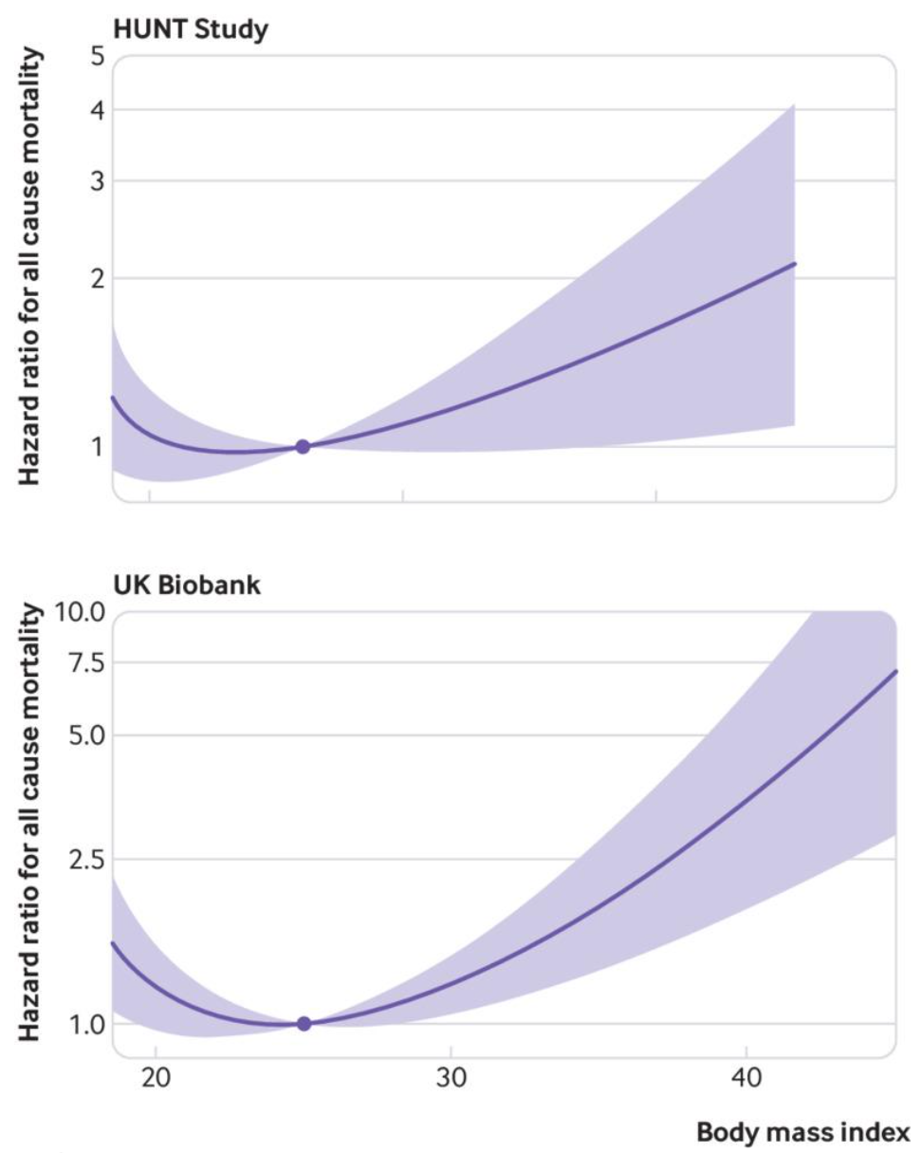
Nonlinear MR
We fit a GRS in strata of the exposure
We get multiple HRs or ORs
We fit a spline/polynomial through the ORs
The ORs are like derivatives, kind of like relative risk in the strata
We need a reference point (like BMI = 25), such that everything is relative to that
U-shaped curve It is worse to be too light weight

Slide 10
Thanks

